Slide 1
Statistical Relationships in Distinctive Feature Models and Acoustic-Phonetic Properties of English Consonants
Ken de Jong, Noah Silbert, Kirsten Regier & Aaron Albin
IU & U Maryland
These slides posted at http://www.indiana.edu/~lsl/ConsP.html

Slide 2
Traditional Consonant Representations
SEGMENTAL (Alphabetic) model
FEATURAL (Feature bundle) model
ORDINAL (Phonetic chart) model

Slide 3
Relations between Representations
Trade-off between specific (providing much flexibility for individual idiosyncrasy), and general (providing much more compact representation for the system)
Most specific: SEGMENTAL: Each consonant requires its own specification
Most general: ORDINAL: Each requires only (in example above) 3 specifications

Slide 4
General Question
To what extent are the properties of these representations evident in aspects of human behavior? Previous work: Perceptual confusions

Slide 5
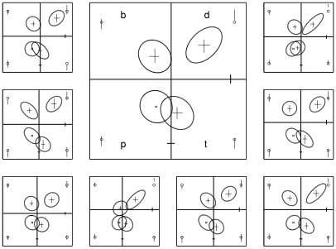
General Question
To what extent are the properties of these representations evident in aspects of human behavior? Previous work: Perceptual confusions
Silbert (to appear): many variations from featural structure are robustly apparent in confusion data
Perceptual distributions for a 2X2 set shown here

Slide 6
Current Question
To what extent are the properties of differently generalized representations evident in production acoustics?

Slide 7
Current Questions
There are many acoustic dimensions in the speech signal; distinctive feature structure is also multi-dimensional; the mapping between the two is many-to-many.
BETWEEN CATEGORIES: are consonant categories arranged in a multi-dimensional acoustic space according to the more general structures (FEATURAL or ORDINAL)?
WITHIN CATEGORIES: Is the internal structure of the consonant categories shared across categories? Or does each consonant have its own distribution in the multi-dimensional space?

Slide 8
Corpus
Talkers: 20 young adult native speakers of American English from the upper Midwest, recruited from Indiana University population
16 English consonants, as listed below
Preceding (ONSET) and following (CODA) vowel /a/
Produced in isolation
10 repetitions of each target pseudo-randomized
3200 tokens per prosodic position, 6400 in all
Recorded onto Marantz PMD 560 Solid-state Recorder at CD samping rate, using a EV RE50 mic in a sound-dampened room.

Slide 9
Acoustic Space
10 dimensions measured from hand-parsed signals using Matlab & Praat:
CONS DUR = duration of consonant epoch: offset occurrence of voiced high-frequency spectra to onset of voiced high-frequency spectra
VOW DUR = duration of vowel epoch of co-syllabic /a/
SPEC V = standard deviation of spectral frequency distribution
SPEC S = skewness of spectral frequencies, indicating diff from central mean
MAX N POW = maximum noise power during cons. epoch for signal > 500 Hz
MAX VOI POW = maximum signal power for < 1000 Hz
AMP DIF = difference in peak noise amplitude from average amplitude, a measure of temporal concentration of noise
F1 POW = measure of F1-cutback in vowel
F2 = Second formant centered at first voicing cycle adjacent to the consonant
F3 = Third formant centered at first voicing cycle adjacent to consonant

Slide 10
General Technique
Fit models via maximum likelihood estimation according to assumptions of 3 category representation models
Build these 3 models with 2 different assumptions concerning the generality of category internal variance = 6 models.
Model fitting (partially) with Ime4 package in R (Bates, 2005; http://www.R-project.org).
Use Baysian Information Criterion to compare goodness of fit of the models.

Slide 11
Model Structures
SEGMENTAL model
Each consonant indicated separately in model.
15 parameters - one for each consonant (-1 for intercept).
FEATURAL model
Consonant indicated as combination of binary features
6 parameters - [coronal] [anterior] [sonorant] [continuant] [strident] & [voice]
ORDINAL model
Consonant indicated by ordinal place on phonetic chart
3 parameters - [place], [manner], and [voice]
[place: labial < alveolar < palato-alveolar < velar]
[manner: nasal < stop < affricate < fricative]

Slide 12
Category - Internal Variance
SHARED COVARIANCE
Model includes a single covariance matrix for the combination of each of the 11 acoustic measures.
The combination of cells introduces 55 additional fitted parameters
SEPARATE COVARIANCE
Model makes no assumptions about acoustic covariance across consonant categories
Model includes a covariance matrix for all 16 consonants
Each matrix has 55 parameters, one for each pairwise combination of 11 acoustic measures
This introduces 917 additional fitted parameters

Slide 13
Evaluation
Model fits to the data employ Baysian Information Criterion (BIC). BIC balances
1) goodness of fit & 2) the complexity of the model.
BIC = -2*ln(L) + ln(N)*k
(L = likelihood) (N = # of datapoints, &
k = # of parameters)
-> Low values of BIC indicate a better model.

Slide 14
Onset Coda
ONSET CODA
BIC Measures

Slide 15
Summary I
BETWEEN CATEGORY BEST ESTIMATES: BIC measures indicate better fits (lower values) for more specific models (SEGMENTAL & FEATURAL) than more general models (ORDINAL), even with added cost of additional parameters
WHY??? – let’s look at some 2-dimensional plots

Slide 16
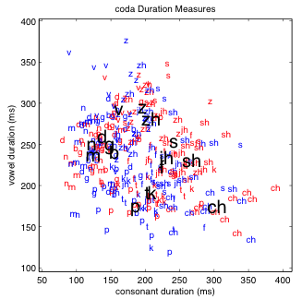
Between Category Structure – Example: Duration measures (Coda)
Duration measures
Note neat diamond structure w/ voicing and manner

Slide 17
Between Category Structure – Example: Duration measures (Coda)
Duration measures
Note neat diamond structure w/ voicing and manner

Slide 18
Between Category Structure – Example: Duration measures (Coda)
Duration measures
Note neat diamond structure w/ voicing and manner
Here, affricate is ‘super voiceless’

Slide 19
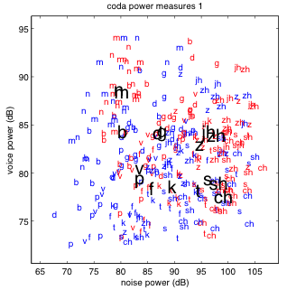
Between Category Structure – Example: Spectral Power (Coda)
Spectral Power (Coda)

Slide 20
Between Category Structure – Example: Spectral Power (Coda)
Spectral Power (Coda)
Note square structure w/ voicing and manner
Here, nasal is ‘super voiced’

Slide 21
Between Category Structure – Example: Spectral Power (Coda)
Spectral Power (Coda)
Note square structure w/ voicing and manner
Here, nasal is ‘super voiced’
BUT: note spread in voiceless stops & misplacement of non-sibilant f&v

Slide 22
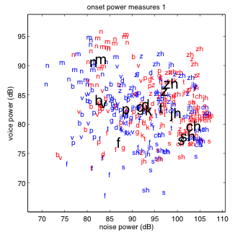
Between Category Structure – Example: Spectral Power (Onset)
AND compare to onset:

Slide 23
Onset Coda
ONSET CODA
BIC Measures

Slide 24
Summary II
BETWEEN CATEGORY BEST ESTIMATES: Segment specific oddities get handled by more specific models, yielding better fits, even with added cost of additional parameters
CATEGORY INTERNAL VARIANCE: In general, BIC measures indicate better fits with separate covariance matrices, especially for codas, despite the enormous number of attendant parameters

Slide 25
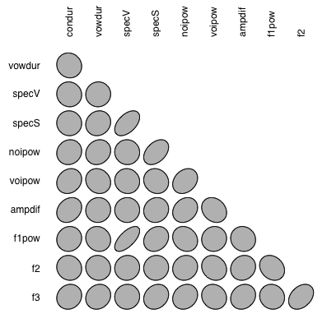
Within-Category Covariance
Ellipse plots of all 2-d combo for onset /d/
Dimensions largely uncorrelated
Some are correlated, though

Slide 26
Within-Category Covariance
Ellipse plots of all 2-d combo for onset /d/
Dimensions largely uncorrelated
Some are correlated, though
If we focus on as subset of relations …

Slide 27
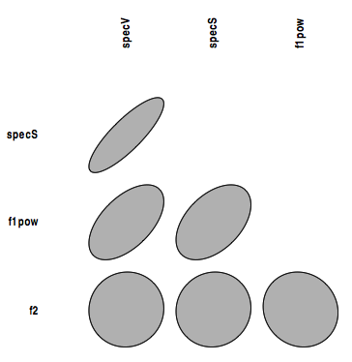
Within-Category Covariance
Ellipse plots of all 2-d combo for onset /d/
Dimensions largely uncorrelated
Some are correlated, though
If we focus on as subset of relations …

Slide 28
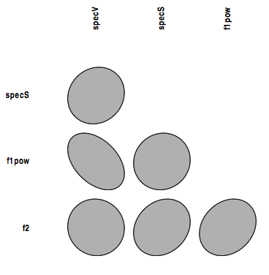
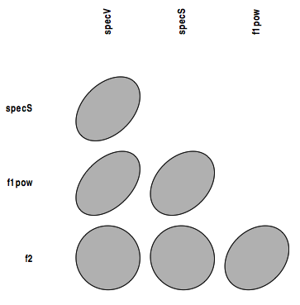
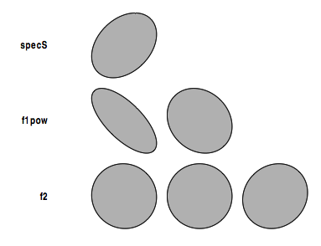
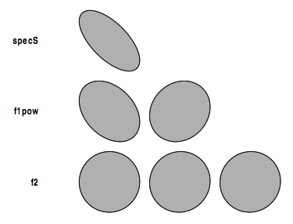
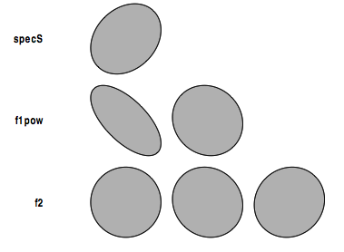
Within-Category Covariance
If we focus on some 2d relations …
And compare across segments …
/b/
/d/
/g/
/p/
/t/
/k/

Slide 29
Next …
Auditory or acoustic: compare effects of ERB transformation
Hybrid models w/ partial feature generalization
Explore more systematically parts of the acoustic space to see where segmental peculiarities are most obvious

