Slide 1
Language differences in the perceptual content of laryngeal contrasts: the role of VOT and F0 in indicating contrasts in Korean, Japanese, English, and Spanish
Eric N. Oglesbee, Ph.D.
Assistant Professor of Linguistics
Bethel College (IN)

Slide 2
Introduction
Perception in multidimensional stimulus spaces
Why?
How?
Experiment 1: Perceptual preferences in a five-cue stimulus space
40 total native speakers
English (10), Spanish (10), Japanese (10), and Korean (10)
Experiment 2: Comparison between perceptual preferences in a six-cue stimulus space and usage of those cues in a production task
12 total native speakers
English (2), Spanish (3), Japanese (2), Korean (2), and Quebec French (3)

Slide 3
Multidimensional Perception
Why be concerned about multiple acoustic cues for a phonological contrast?
Multiple cues may be needed to disambiguate a group of sounds at a single point of articulation within a language.
Ex. Overlapping VOT distributions in Korean fortis and lenis stops (Lisker & Abramson, Figure 5, 1964)

Slide 4
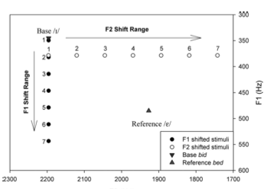
Multidimensional Perception
Why be concerned about multiple acoustic cues for a phonological contrast?
Even though manipulating
a single cue can cause a
category shift for a listener, this
does not mean that the
manipulated cue is the only
one relevant to categorization.
Ex. Single formant shifting
(Oglesbee & Kewley-Port, Figure 1, 2009)

Slide 5
Multidimensional Perception
How can multiple cues be studied in a single experiment?
Forced-choice approaches to categorization are too cumbersome
5 cues with 10 different settings = 10⁵ (100,000) unique stimuli
Oglesbee & de Jong (2007) proposed an Algorithm for Multidimensional Best Exemplar Locations (AMBEL)
Using goodness judgments provided by the listener, the algorithm identifies regions of the stimulus space containing the best exemplars.
The algorithm also identifies the cues that most affect a listener’s judgment of the stimulus.

Slide 6
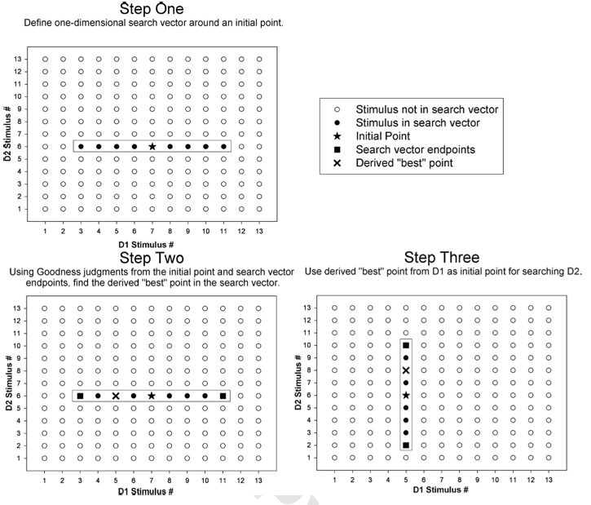
Multidimensional Perception
General search method
Fig. 1 from Oglesbee & de Jong (2007)
Subject interface

Slide 7
Multidimensional Perception
Additional notes concerning AMBEL:
The initial point of the search can be anywhere.
Center of stimulus space used as initial point in all reported experiments.
Using the same stimulus space with the same initial starting point allows for direct comparisons between languages.
AMBEL is a “first approximation” tool that gives distributions of best exemplars.

Slide 8
Exp. 1: Perception
Acoustic Cues:
Voice Onset Time (25 levels)
Closure voicing
Voicing lag
Formant Transitions (7 levels)
F0 Register (7 levels)
F0 Initial Contour (11 levels)
Vowel Amplitude Contour (11 levels)
TOTAL # STIMULI: 148,225

Slide 9
Exp. 1: Perception
Acoustic Cues:
Voice Onset Time (25 levels)
Closure voicing
Voicing lag
Formant Transitions (7 levels)
F0 Register (7 levels)
F0 Initial Contour (11 levels)
Vowel Amplitude Contour (11 levels)
TOTAL # STIMULI: 148,225

Slide 10
Exp. 1: Perception
Participants:
English (10)
Japanese (10)
Korean (10)
Spanish (10)
3 destination points per participant = 30 per category

Slide 11
Exp. 1: Perception
Spanish
VOT
No F0

Slide 12
Exp. 1: Perception
Spanish
VOT
No F0
English
VOT
Minor F0

Slide 13
Exp. 1: Perception
Spanish
VOT
No F0
English
VOT
Minor F0
Japanese
VOT
F0

Slide 14
Exp. 1: Perception
Spanish
VOT
No F0
English
VOT
Minor F0
Japanese
VOT
F0
Korean
VOT
F0

Slide 15
Exp. 1: Perception
Key Observations:
F0 weighting appears to be a linguistic specification
A two-category language can have specifications for two non-redundant cues
E.g. Japanese
A three-category language can weight cues differently for each pairwise contrast
E.g. Korean
Fortis-Lenis: F0
Fortis-Aspirated: VOT & F0
Lenis-Aspirated: F0 & VOT

Slide 16
Exp. 2: Production
A related experiment examined within subject relationships between
the cues that speakers were sensitive to in perception, and
the acoustic cues participants manipulated in a lexical disambiguation task.
Experimental Tasks
Perception: AMBEL protocol in a 6-dimensional stimulus space (256,025 stimuli)
Voice Onset Time (19 levels)
Closure voicing
Voicing lag
Formant Transitions (7 levels)
F0 Register (7 levels)
F0 Initial Contour (5 levels)
Vowel Amplitude Contour (11 levels)
Burst Amplitude (5 levels)

Slide 17
Exp. 2: Production
Experimental Tasks (cont.)
Production: Lexical disambiguation task
Ex. “No, I did not say “bot”, I said “pot”.
(non-focused) (focused)
For languages other than English, comparable sentence frames were constructed by native speakers of the languages being studied.

Slide 18
Exp. 2: Production
Production Measurements
Acoustic measurements were taken for the following cues
VOT
Proportion of closure voicing
Voicing lag
F0 Register
Average F0 over the 60-80 ms time frame
F0 Initial Contour
Average F0 over the 0-40 ms time frame
Vowel Amplitude Contour
Initial amplitude relative to vowel midpoint
Slope of the line connecting the amplitude at vowel onset and amplitude at 15% duration of the vowel.

Slide 19
Exp. 2: Production
Results
The lexical disambiguation task affected the production of contrast cues differently across languages
 | % Total Focus Interactions | % Contrast Expansion | % Contrast Reduction
English | 33.0 | 100.0 | 0.0
Japanese | 25.0 | 0.0 | 100.0
French | 11.1 | 0.0 | 100.0
Spanish | 11.1 | 50.0 | 50.0
Korean | 19.4 | 28.6 | 71.4

Slide 20
Exp. 2: Production
Results
In English, focus primarily resulted in the expansion of contrasts within the dimensions that listeners used for perception.

Slide 21
Conclusion
Conclusions
Work supported by NSF Grant 0446540

Slide 22
Extra Slides

Slide 23
Exp. 1: Perception
Spanish
VOT
No F0
English
VOT
Minor F0
Japanese
VOT
F0
Korean
VOT
F0

Slide 24
Exp. 1: Perception
Spanish
VOT
No F0
English
VOT
Minor F0
Japanese
VOT
F0
Korean
VOT
F0

Slide 25
Exp. 1: Perception
Spanish
VOT
No F0
English
VOT
Minor F0
Japanese
VOT
F0
Korean
VOT
F0

Slide 26
Exp. 1: Perception
Spanish
VOT
No F0
English
VOT
Minor F0
Japanese
VOT
F0
Korean
VOT
F0

